Slide 1
Rice Leaf Disease Detection Tool Based on CNN Model
Group 3
Ray Li, Rittle Li, Isabella Tian

Slide 2

Intro

Slide 3
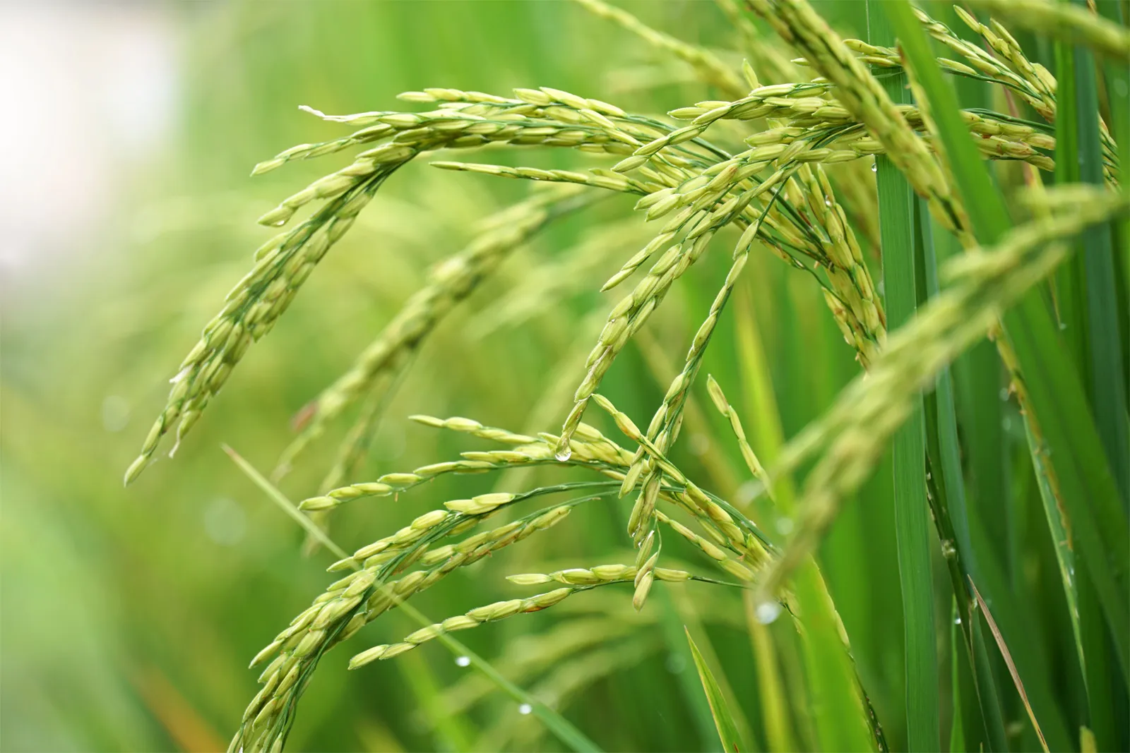
Product Concept and Overview
A rice leaf disease detection tool which can automatically detect and classify different types of rice leaf diseases.
(Leaf smut, Brown spot, Bacterial leaf blight)

Slide 4
Product AI Canvas
Opportunity
Rice is one of the most important staple foods in the world. However, rice crops are susceptible to various diseases that can cause significant yield losses and affect the quality of the crop.
Solution
Introduce an automatic classification tool to the rice leaf disease detection process.
Consumers
Rice farmers and agricultural companies
Data
Rice leaf images
Strategy
Collect and process valuable plant image data. Automate the disease detection process.
Policy and Process
Data collection process can involve budget and legal right issues.
Transfer Learning
Based on past research papers about rice leaf disease classification.
Success Criteria
The additional profit the product brings to rice farmers and agricultural companies

Slide 5
Value of Data for User
Time savings
By automating the diagnosis process, the product can save farmers a considerable amount of time compared to manual inspections.
Reduced costs
The product can help reduce the costs associated with traditional methods of disease detection and control.
Notes:
Who will buy the product:
Target customers: Rice farmers and agricultural companies in regions where rice is a major crop
Target markets: Countries such as China, India, Indonesia, Bangladesh, and Vietnam
Additional target customers: Research institutions and companies involved in developing new treatments and management strategies for rice diseases
Potential impact: Positive impact on global food security
How we gain profits through the product:
Charge subscription fee based on the number of crops and fields being monitored
Offer different pricing tiers for small, medium, and large-scale farmers and companies
Provide customer support and training based on the types of rice diseases detected on crops
Enables farmers to take prompt action to prevent disease and reduce the need for harmful pesticides and chemical inputs
Promotes sustainable and eco-friendly agricultural practices
Possible future expansion to monitor all kinds of crops and plants, bringing significant value to agriculture and society as a whole.

Slide 6
Product Team & Required Roles for Concept Development
Engineering Team
Data Engineer
Machine Learning Engineer
Frontend Developer
Backend Developer
DevOps Engineer
Product Team
Product Manager
UI/UX Designer
BI Engineer/Data Analyst

Slide 7
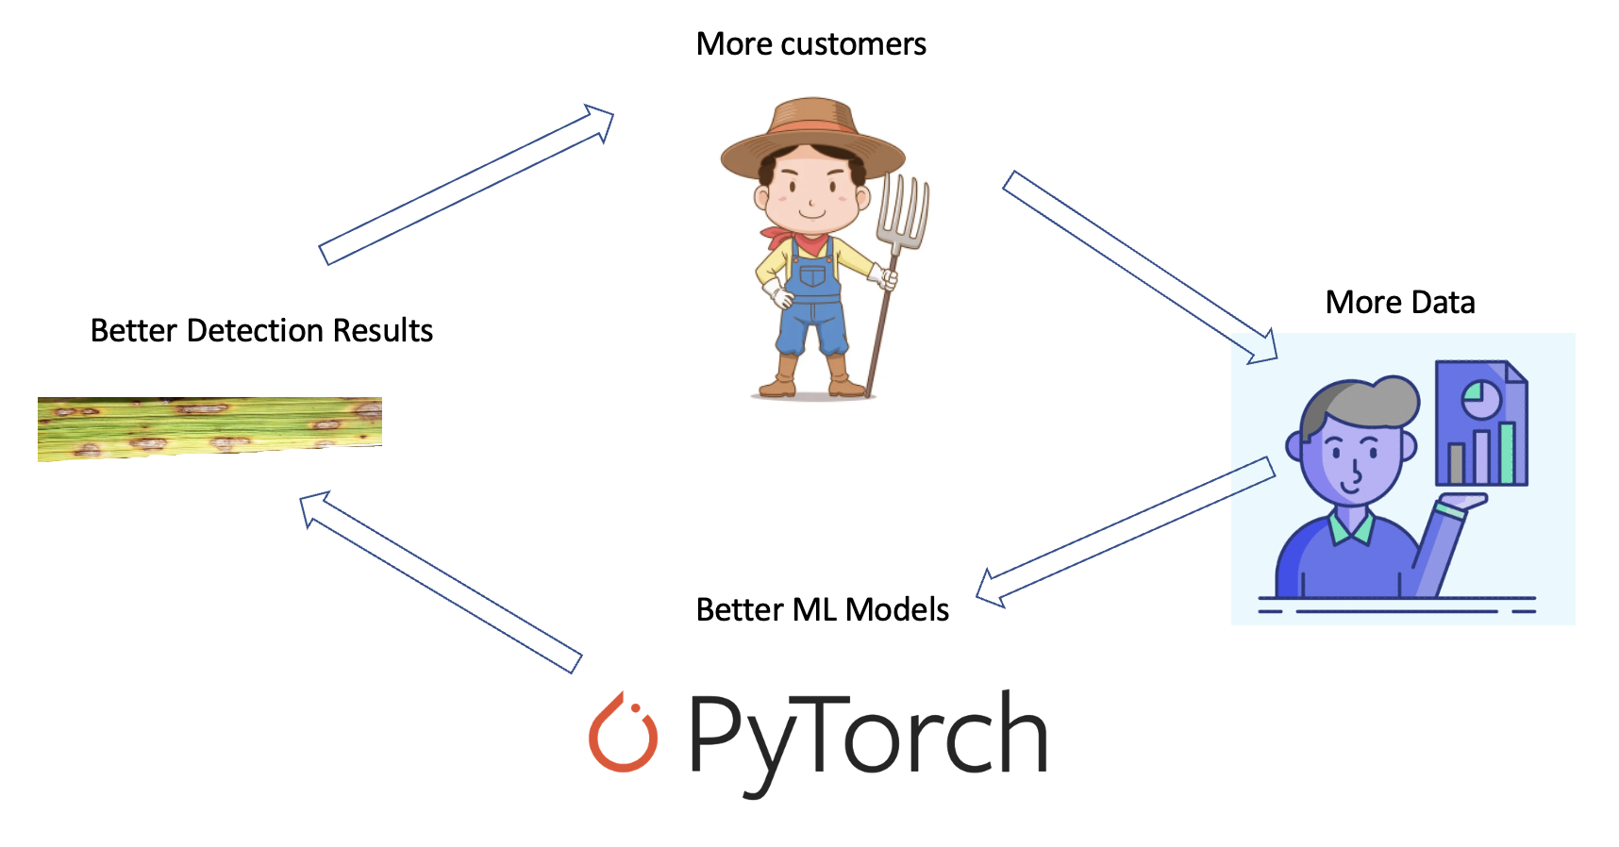
Data Flywheel & Data Network Effects
Notes:
Who will buy the product:
Target customers: Rice farmers and agricultural companies in regions where rice is a major crop
Target markets: Countries such as China, India, Indonesia, Bangladesh, and Vietnam
Additional target customers: Research institutions and companies involved in developing new treatments and management strategies for rice diseases
Potential impact: Positive impact on global food security
How we gain profits through the product:
Charge subscription fee based on the number of crops and fields being monitored
Offer different pricing tiers for small, medium, and large-scale farmers and companies
Provide customer support and training based on the types of rice diseases detected on crops
Enables farmers to take prompt action to prevent disease and reduce the need for harmful pesticides and chemical inputs
Promotes sustainable and eco-friendly agricultural practices
Possible future expansion to monitor all kinds of crops and plants, bringing significant value to agriculture and society as a whole.

Slide 8
Data Summary
Total number of images: 120
Image size: 256 x 256 pixels
Number of classes: 3(Bacterial leaf blight, Brown spot, Leaf smut)
Class distribution:
Brown spot: 40 images (33.3%)
Leaf smut: 40 images (33.3%)
Bacterial leaf blight: 40 images (33.3%)
Image format: JPEG
Dataset source: UCI Machine Learning Repository
(https://archive.ics.uci.edu/ml/datasets/Rice+Leaf+Diseases#)
Use case: Training machine learning models to detect and classify rice leaf diseases.

Slide 9
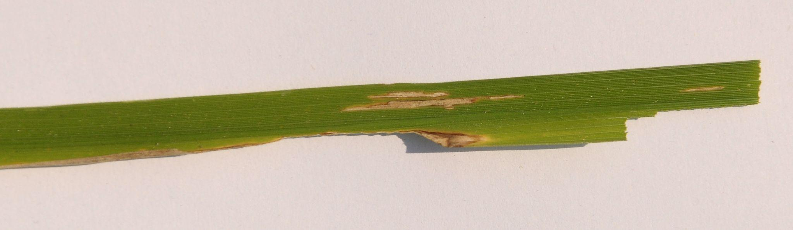
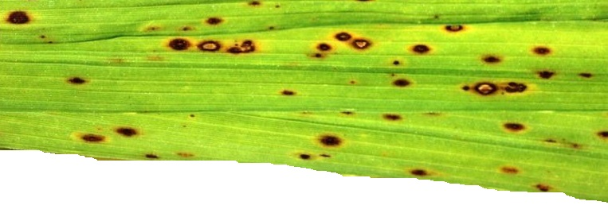
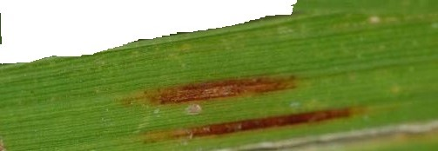
Labels of data
Bacterial leaf blight
Brown spot
Leaf smut

Slide 10
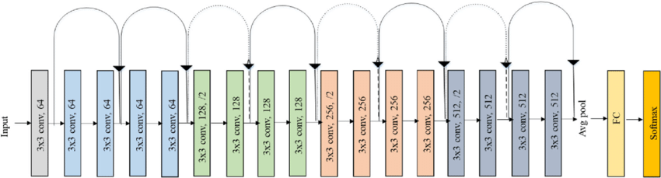
Model Type Selection
ResNet18
Notes:
Residual networks, or ResNets, were introduced to address this problem by using a "skip connection" to bypass one or more layers in the network. The idea is that the information from the input can directly propagate to the output through the shortcut connections, allowing the network to learn the residual (or difference) between the input and output more easily. This makes it easier to train very deep neural networks, as the gradients can be propagated more easily through the network.

Slide 11
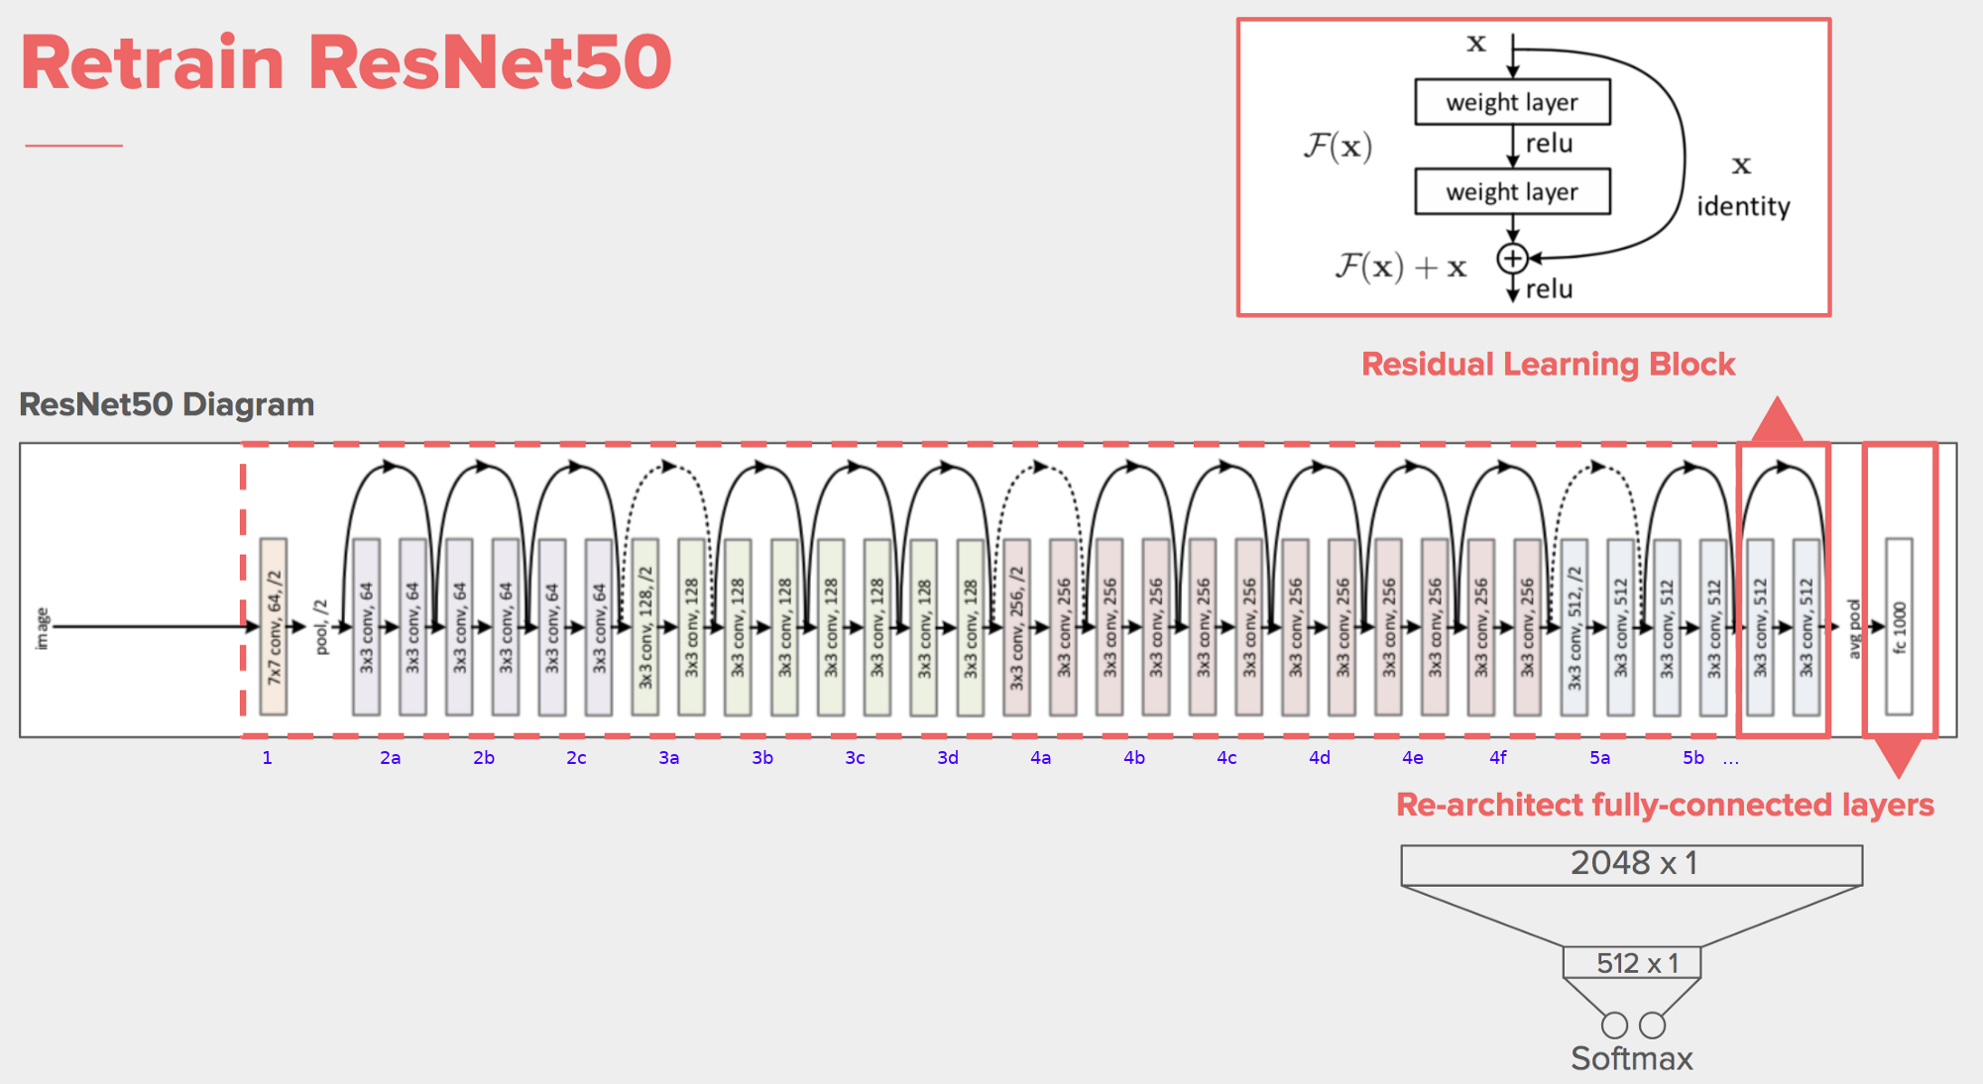
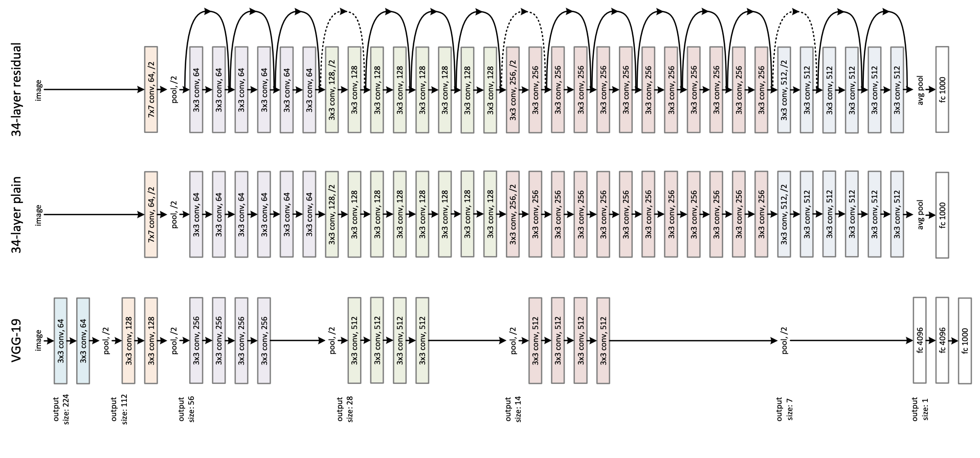
ResNet 50

Slide 12
Preprocess
Transformer:
.RandomEqualize()
.RandomPerspective()
.RandomPosterize(4)
.RandomAdjustSharpness(2)
.RandomHorizontalFlip()
.RandomAutocontrast()
.RandAugment()
Train-test split:
test_size 18
valid_size 18
train_size 84

Slide 13
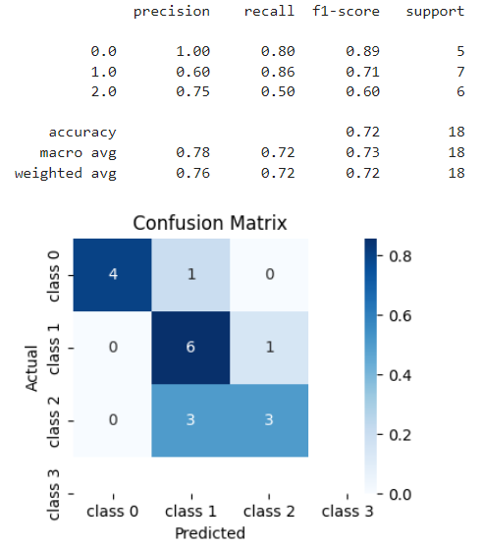
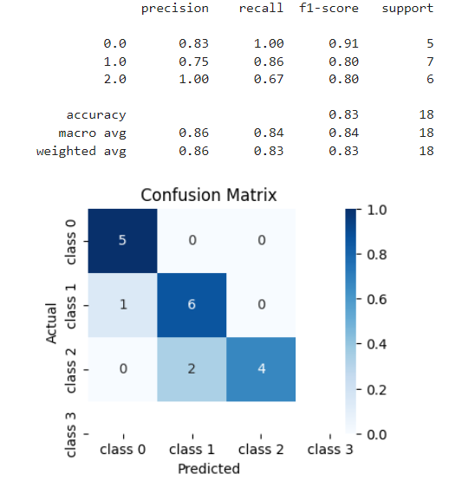
Model Performance

Slide 14
MVP Demo
https://huggingface.co/spaces/ziruili1020/Rice-Leaf-Disease-Detector

Slide 15
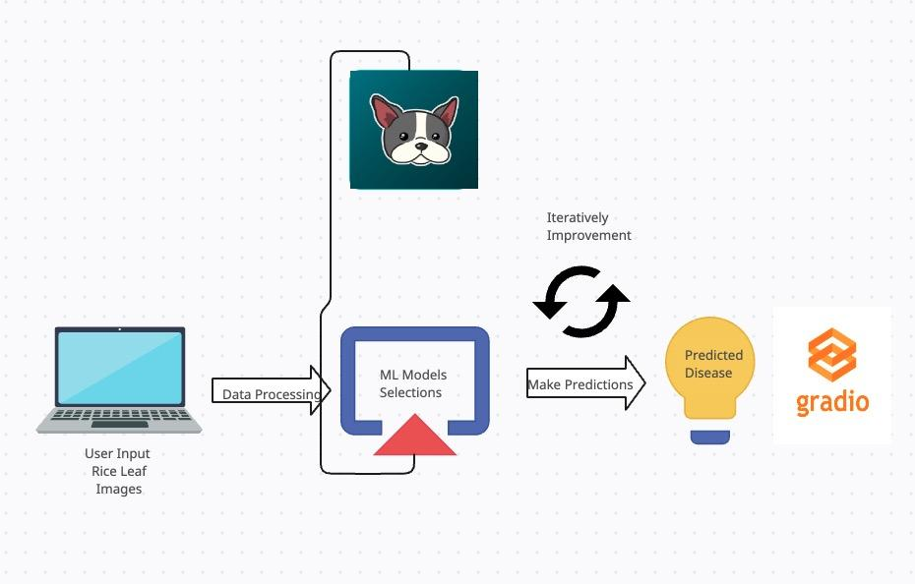
Proposed MVP Architecture
Notes:
Data Collection and Preprocessing: Collect a dataset containing images of healthy and diseased rice leaves. Clean the dataset to ensure a diverse set of examples for training.
Model Selection and Training: Choose an appropriate machine learning model, CNN, which is well-suited for image classification tasks. Train the model on the dataset using cross-validation and fine-tune the hyperparameters to achieve optimal performance.
Evaluation: Assess the model's performance using relevant metrics such as accuracy, precision, recall, and F1 score.
Deployment: Create an API or a simple user interface to enable users to input images of rice leaves and receive disease predictions from the model.
User Feedback: Collect user feedback on the MVP to identify areas for improvement, potential bugs, and any additional features that could enhance the product.
Iterative Improvement: Continuously update and improve the model based on user feedback, new data, and advancements in machine learning techniques. This will ensure the model stays relevant and effective in predicting rice leaf diseases.

Slide 16
Proposed MVP Architecture(continued)
The MVP architecture should focus on the core functionality of disease prediction while minimizing complexity. Once the MVP is tested and validated, you can build upon it by adding advanced features such as localization of disease spots, integration with farming management systems, or expanding to predict other types of crop diseases.

Slide 17
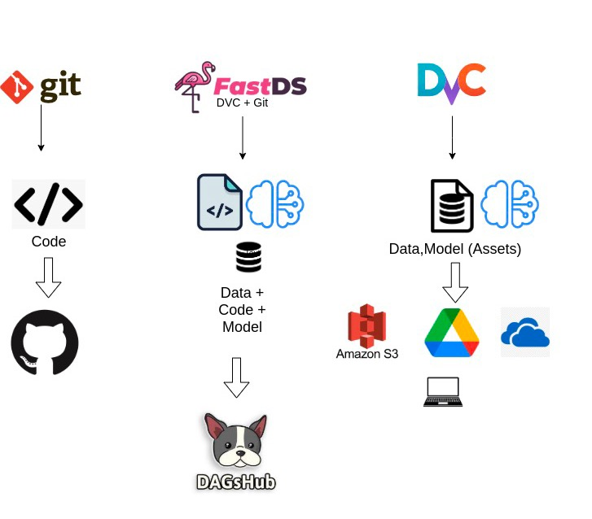
Proposed Production Architecture

Slide 18
Some Considerations…
Infrastructure and Performance: As the number of users and requests increases, the backend infrastructure should be able to handle the growing load. Optimize the machine learning model for speed and efficiency.
Data Storage and Management: As more users contribute data, the storage and management of the dataset become critical. Adopt scalable and cost-effective data storage solutions like DVC.
Data Collection and Labeling: As we collect more data, we need to keep the data quality to ensure the model accuracy. Also, data labeling is expensive and needs domain expertise.
Extensibility and Modularity: As the product evolves, we expect our product can be used in more sort of plants. More features and more high-quality data may be needed.
Monitoring and Analytics: Implement monitoring and analytics tools to track system performance, user engagement, and other relevant metrics. These insights can inform decision-making and help identify areas for improvement or potential bottlenecks that need to be addressed.
Notes:
Data storage: Implement data management best practices, such as version control, data backup, and data retention policies to ensure data integrity and reliability.
Genre/Geographic Expansion: If the rice leaf disease ML model product is successful in one region, consider expanding to other locations. Take into account language barriers, cultural differences, and varying disease prevalence in different regions. Optimize the model for each region by incorporating region-specific data and adapting to local agricultural practices.
Data quality: The quality of your data is crucial for the accuracy and reliability of your deep learning model. Ensure that your data is clean, consistent, and representative of the problem you are trying to solve. This can involve measures such as data cleaning, preprocessing, and augmentation.
Data diversity: In order to build a robust and generalizable deep learning model, it is important to have a diverse range of data that covers different variations and scenarios of the problem you are trying to solve. This can help avoid bias and overfitting in your model.
Data labeling: Accurate and consistent data labeling is essential for the performance of your deep learning model. It is important to have a clear and standardized labeling process, as well as expert annotators who have a deep understanding of the problem and can provide high-quality annotations.
Support and Maintenance: As the user base grows, so will the need for customer support and maintenance. Establish a reliable support system to assist users with any issues, and regularly update and maintain the platform to ensure its continued effectiveness.

Slide 19
Some Considerations…(Continued)
Ethics & Governance
Data Privacy and Security: Ensuring user data is protected and treated with care is crucial. Obtain explicit user consent before collecting data and comply with relevant data privacy regulations (such as GDPR or CCPA).
Transparency and Explainability: Users may be concerned about the "black box" nature of some ML models, making it difficult to understand how the model arrived at a particular prediction.
Environmental Impact: Consider the environmental footprint of the ML model, particularly during the training phase, which can consume significant computational resources and energy. Optimize the model for energy efficiency and utilize cloud infrastructure providers with strong commitments to renewable energy sources
Notes:
Data: Implement strong access controls, encryption, and secure data transmission methods to safeguard user information.
Transparency: Strive for transparency by explaining the model's workings, limitations, and assumptions. Consider using explainable AI techniques to provide insights into the model's decision-making process.
Collaboration with Stakeholders: Engage with stakeholders, including farmers, agronomists, and agricultural researchers, to better understand their needs and concerns. Incorporate their input into the product's development to ensure it addresses real-world problems and respects local customs and practices.
By proactively addressing these ethical considerations, you can create a responsible and trustworthy rice leaf disease ML model product that benefits users while minimizing potential harm

Slide 20
Thank you !

